Slide 1

Option Valuation
Valuations and financial risk unit

Slide 2

What is An Option?
What are they ?
An option is a financial contract
Buying a right to buy or sell
Favourable move ? Exercise for profit
Unfavourable move ? Don’t exercise and lose option price
Limiting loss and can be used for hedging
They are still risky

Slide 3
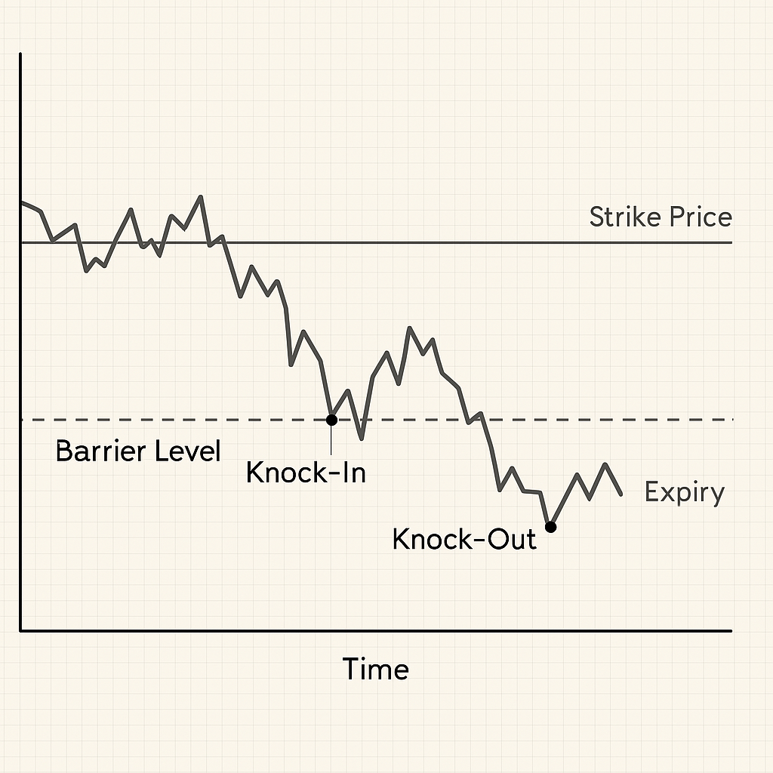
Barrier Options?
What are they? • “knock-out” • “knock-in”
• “double”
Favourable move? Payoff works normally once it’s active (or if it hasn’t knocked out yet)
Unfavourable move? Crossing the barrier can deactivate it (knock-out) or might never activate it (knock-in)
Often cheaper premium Barrier condition can limit payouts, they cost less than vanilla options

Slide 4
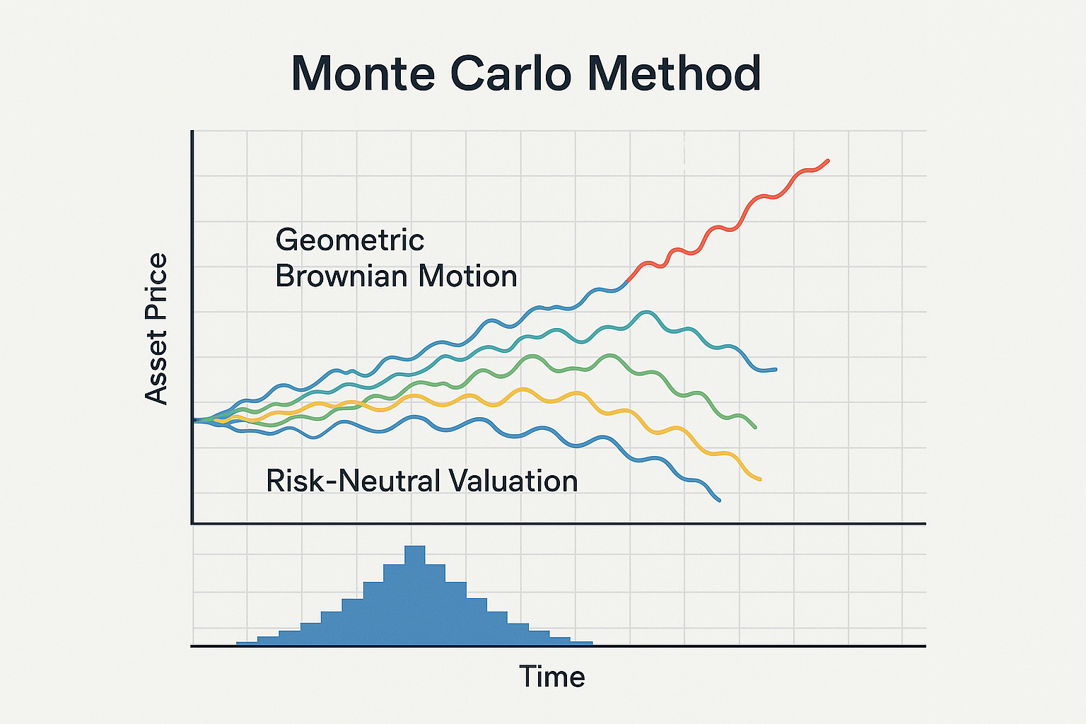
Monte Carlo Method
Randomly generating many possible paths
For each path, you compute the option’s payoff
We discount it back at the risk-free rate, and then average across all paths.
That average becomes the estimated option price.
Talk about advantages

Slide 5
The Option
Two Performance Thresholds:
H1 = $65
H1
H2
H2 = $75
C1:
Number of days St > H1
C2:
Number of days St > H2
K = $50
If ST ≤ K:
Payoff = 0

Slide 6
Share Price at Maturity
ST > K
C2 ≥ 150
ST ≤ K
ST > K
C1 ≥100
C2 < 150
AVG(C1, C2) < 125
ST > K
C1 < 100
ST > K
C1 ≥ 100
C2 < 150
ST – K + 30
= ST - 20
= 0
ST – K + 10
= ST - 40
= 10
ST – K
= ST - 50

Slide 7
Share Price at Maturity
ST > K
C2 ≥ 150
ST ≤ K
ST > K
C1 ≥100
C2 < 150
AVG(C1, C2) < 125
ST > K
C1 < 100
ST > K
C1 ≥ 100
C2 < 150
ST – K + 30
= ST - 20
= 0
ST – K + 10
= ST - 40
= 10
ST – K
= ST - 50

Slide 8
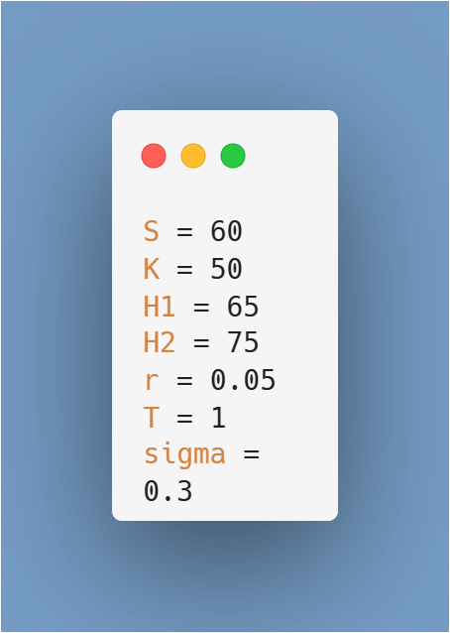
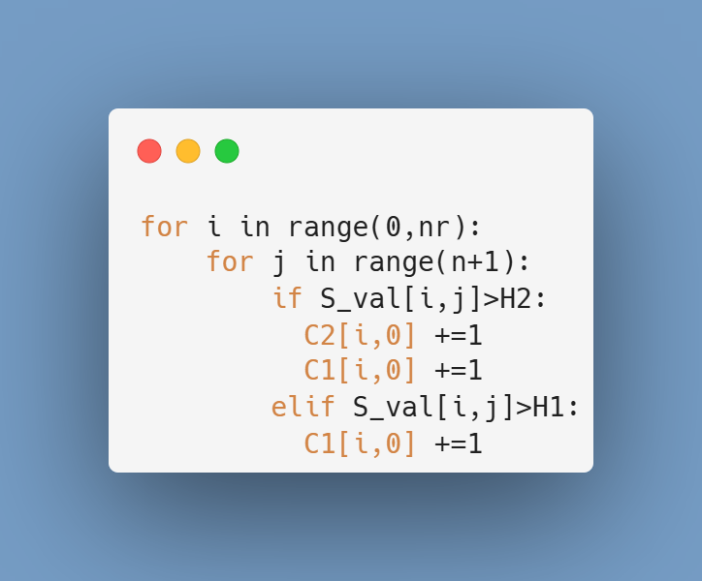
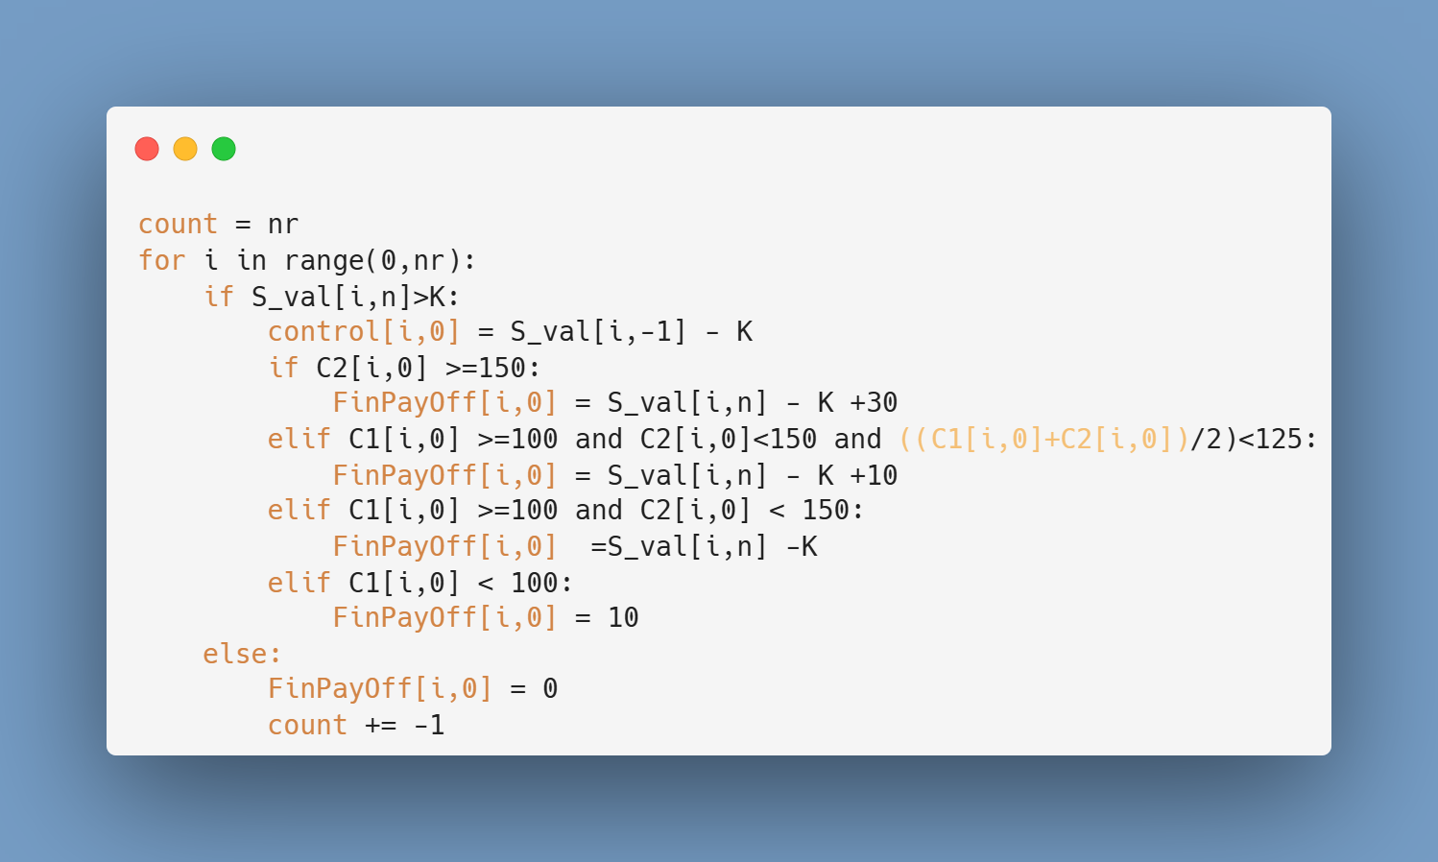
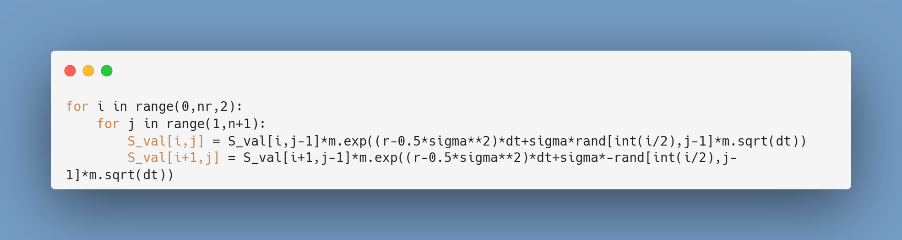
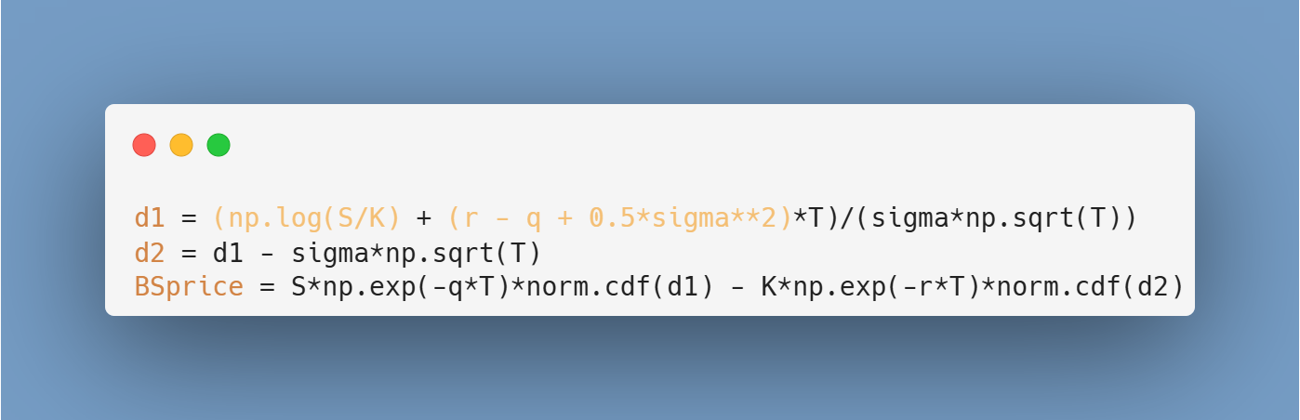
The Code
1. Input Variables
2. Simulate Share Price
3. Count Performance Thresholds
4. Calculate Final Payoff
5. Black Scholes Price
6. Apply Control Variate Technique

Slide 9
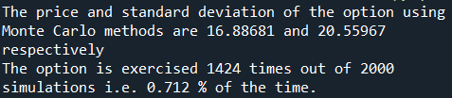
Goodness of Results
We evaluated the quality of our option pricing using three methods: standard Monte Carlo, control variates, and antithetic variates. The basic Monte Carlo method resulted in a high standard deviation, showing significant uncertainty.

Slide 10
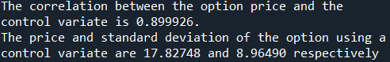
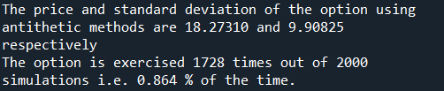
Variance Reduction
We use Control Variate Techniques for their lower standard deviation
By applying control variates, we improved accuracy, reducing the standard deviation to 8.96 backed by a strong correlation of 0.89 between the option payoff and control variable.
The antithetic variates method also significantly reduced variance and produced a slightly higher price, suggesting better reliability.
There is a consistently higher or equal probability of exercise with variance reduction techniques. (0.864% & 0.712% ≥ 0.712%)
std change: 20.56 -> 8.9
Price change: 16.89 -> 17.83
The number of times we exercise the option remains unchanged (0.712% of the time)
std change: 20.56 -> 9.91
Price change: 16.89 -> 18.27

